Slide 1
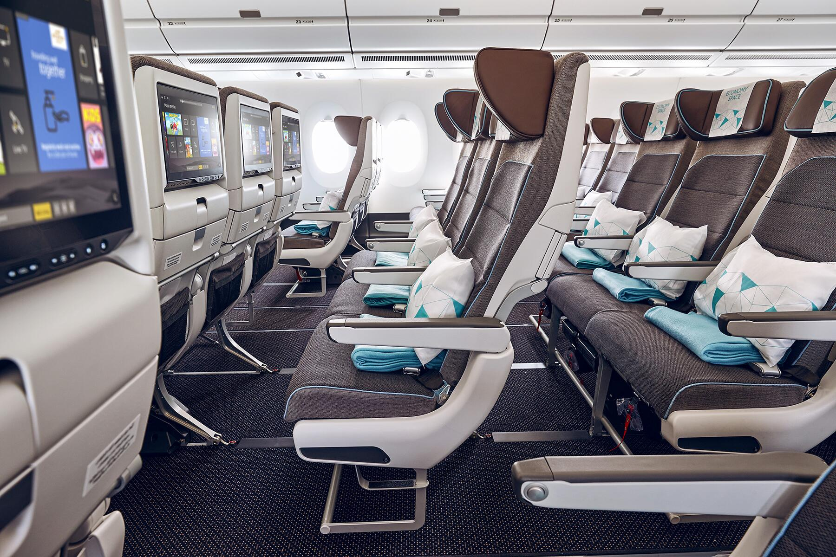
Airline passenger satisfaction

Slide 2
Our Team
Meenakshi Bhat
Anish Jasti
Shreyas Joshi
Sai Krishna Kanthala
Mahima Ashok Kriplani

Slide 3






Introduction
The dataset consists of customer satisfaction with respect to airline services as : Satisfied / Neutral or Dissatisfied) from 120,000+ airline passengers.
It contains information about each passenger as per the following categories:
Demographics: Gender, Age
Type of customer: First-time / Returning
Class of airline travelled by : Business, Economy, Economy plus
Type of travel : Business / Personal
Flight specific features : Flight Distance, Departure Delay, Arrival Delay
Ratings provided by the customer for various airline services : Ease of Online Booking, Check-in Service, Online Boarding, Gate Location, On-board Service, Seat Comfort, Leg Room Service, Cleanliness

Slide 4
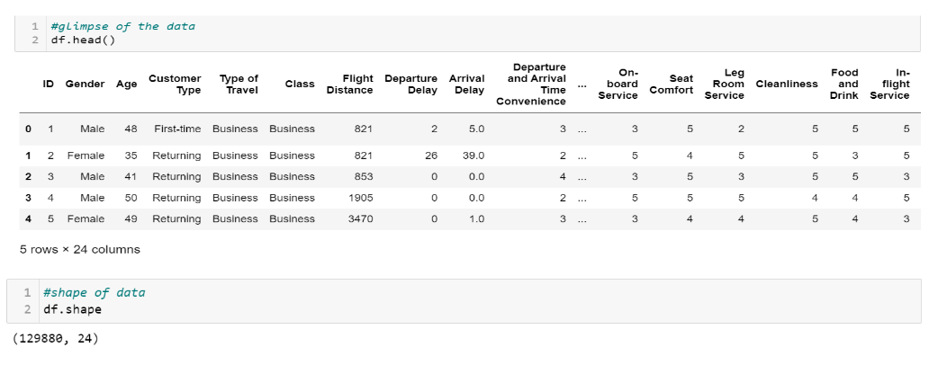
Glimpse of the dataset

Slide 5
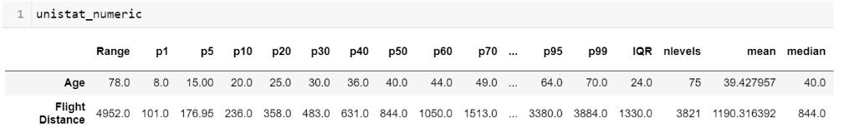
Data cleaning (Univariate Analysis - Numeric) : Step 1
In Univariate analysis for the numeric variables, we look at different characteristics in the each variable of the dataset such as :
Minimum value, Maximum value, Interquartile range, Range, Standard deviation, Mean, Percentile values, Missing percentage.
We then remove those variables from the dataset which :
do not have at least 99% values present (fill rate).
do not have enough variability i.e. (1st percentile = 99th percentile)

Slide 6
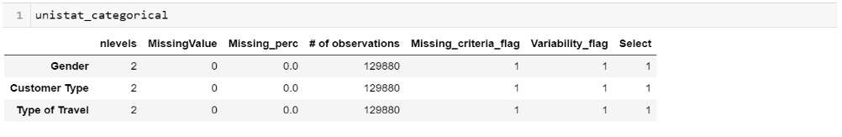
Data cleaning (Univariate Analysis - Categorical) : Step 2
In Univariate analysis for the categorical variables, we look at different characteristics in the each variable of the dataset such as :
Missing percentage, number of unique levels.
We then remove those variables from the dataset which :
do not have at least 99% values present (fill rate).
have less than 2 levels or greater than 500 levels

Slide 7
Data cleaning (Missing value handling) : Step 3
After performing univariate analysis for the numeric and categorical variables, we found that none of the variables could be disposed.
Next, we move on to handling the missing values in our dataset since ‘Missing data reduces the statistical power of the analysis, which can distort the validity of the results’.
Only one variable had missing values, since only 0.3% values were missing in it (‘Arrival Delay’) , we replaced it with mean of the column.
Finally, there were no nulls present in the data.

Slide 8
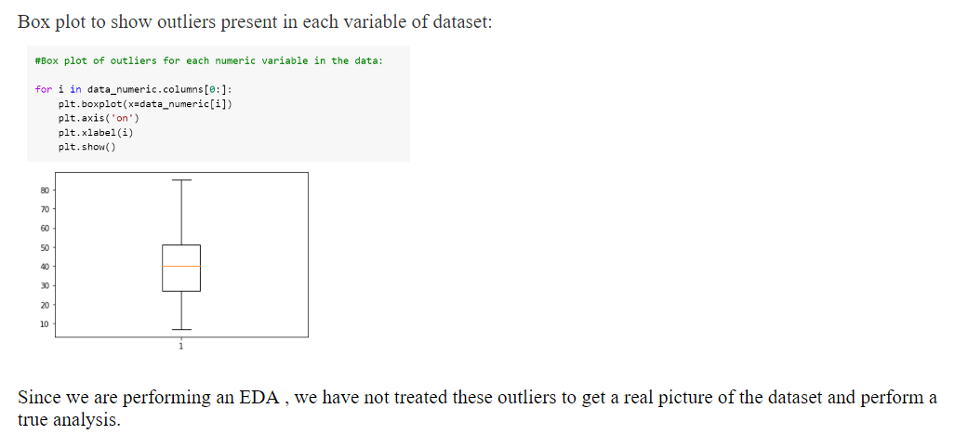
Data cleaning (Outlier treatment) : Step 4

Slide 9
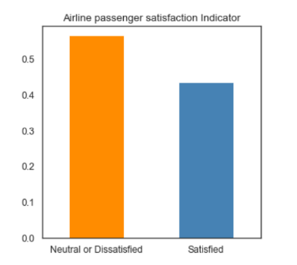
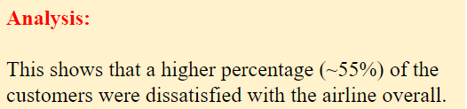
Y variable Analysis
The target variable in this case is Satisfaction which takes 2 values :
Satisfied
Neutral/dissatisfied
Consequently, we will dive into the factors that have led to a greater dissatisfaction, develop insights and define proposed solutions for the same through an exploratory data analysis.

Slide 10
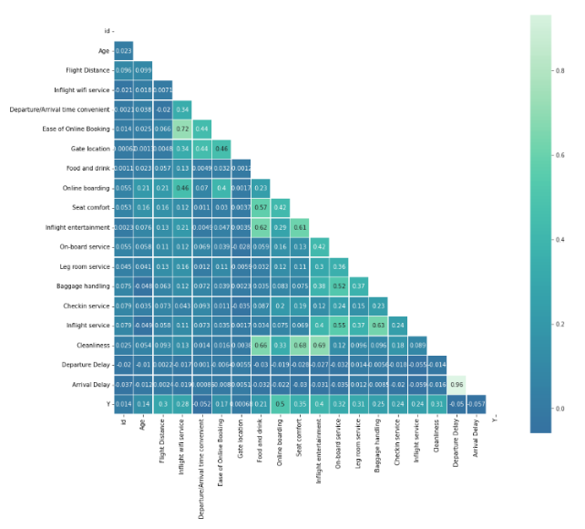
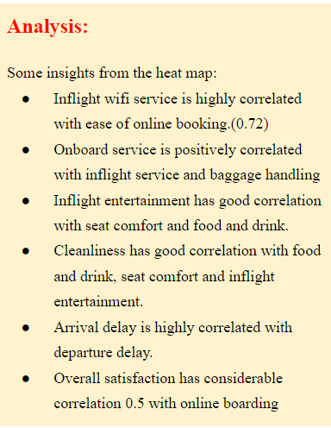
Correlation matrix

Slide 11
EXPLORATORY DATA ANALYSIS
A passenger’s flight journey !

Slide 12
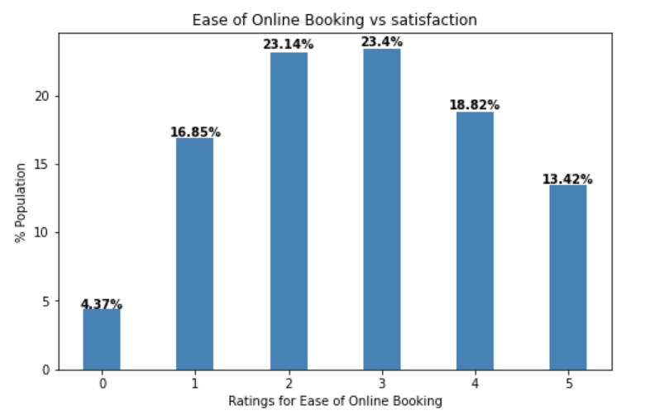
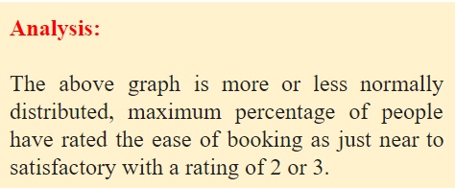
Analysis of satisfaction vs. Ease of online booking
How does satisfaction among age groups vary with ease of online booking?

Slide 13
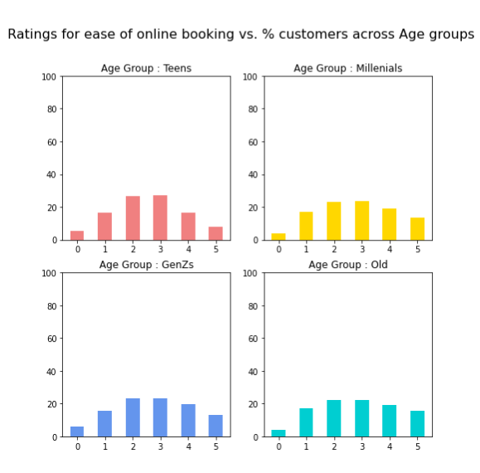
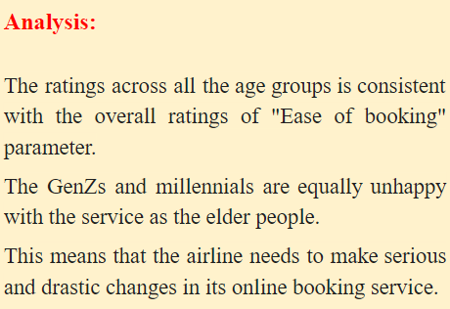

Slide 14
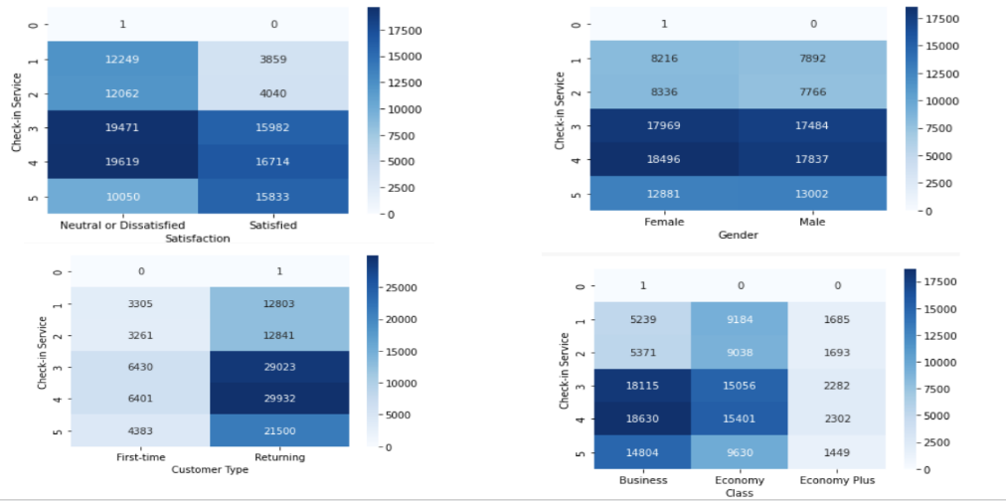
Analysis of satisfaction vs. Check in service
How does satisfaction vary with check-in service?
We map the Check-in service vs Satisfaction, Gender, Customer Type and Class.

Slide 15
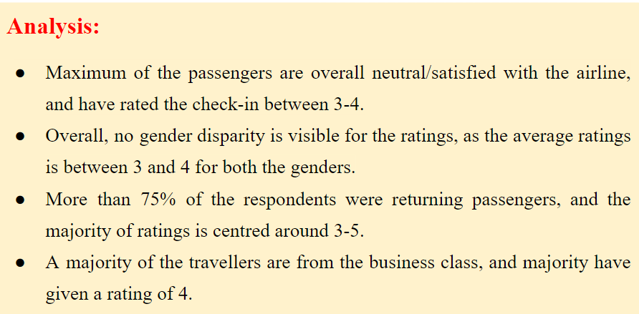

Slide 16
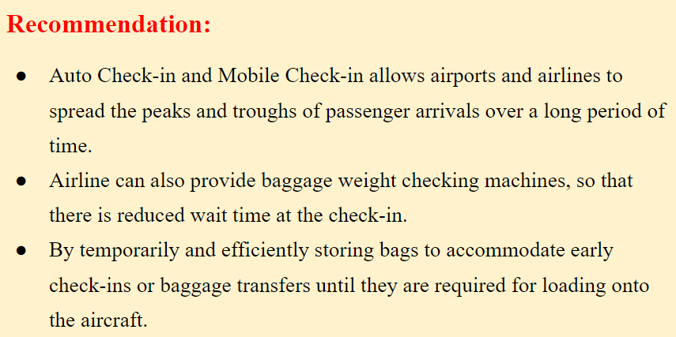

Slide 17
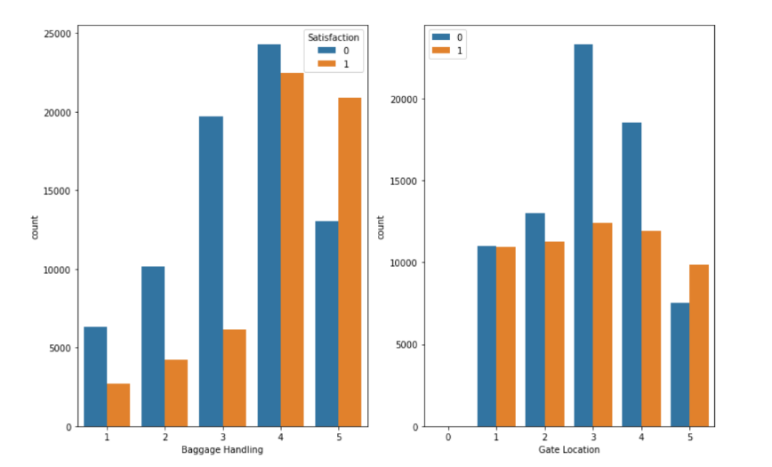
Analysis of satisfaction vs. Baggage Handling and gate location
How does satisfaction vary baggage handling and gate location?

Slide 18
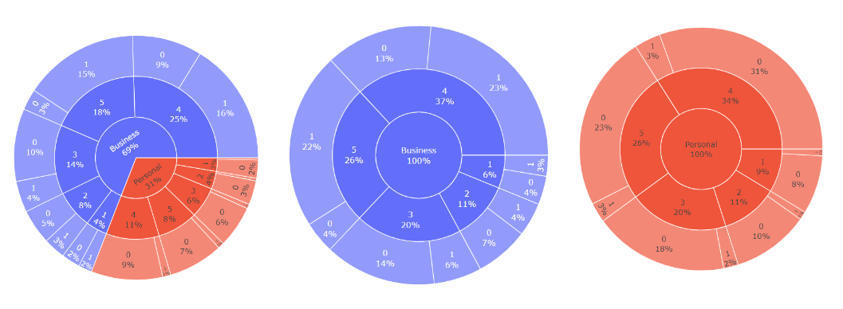
Analysis of satisfaction vs. Baggage Handling

Slide 19
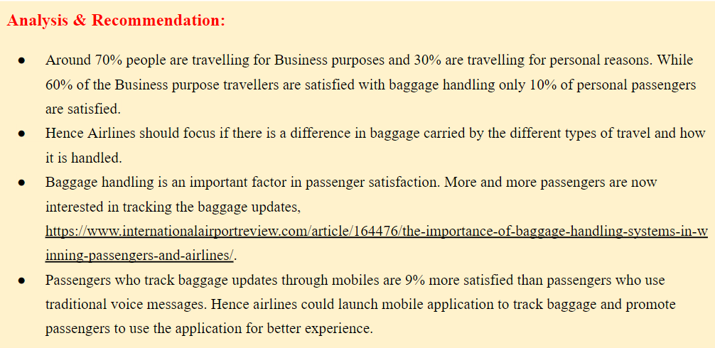

Slide 20
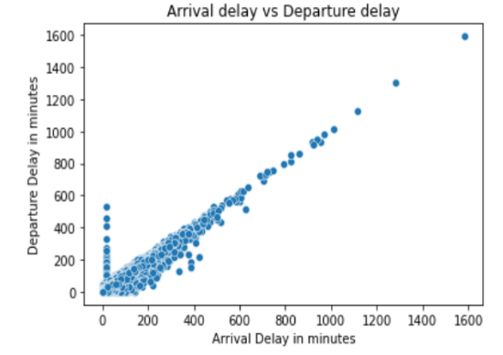
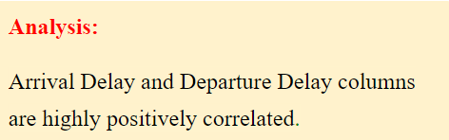
Analysis of satisfaction vs. Flight Delay
How does delay affect satisfaction?

Slide 21
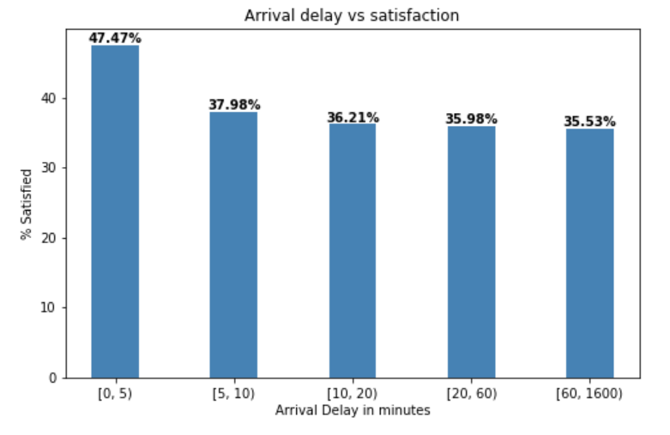
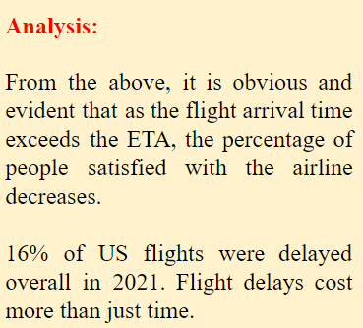

Slide 22
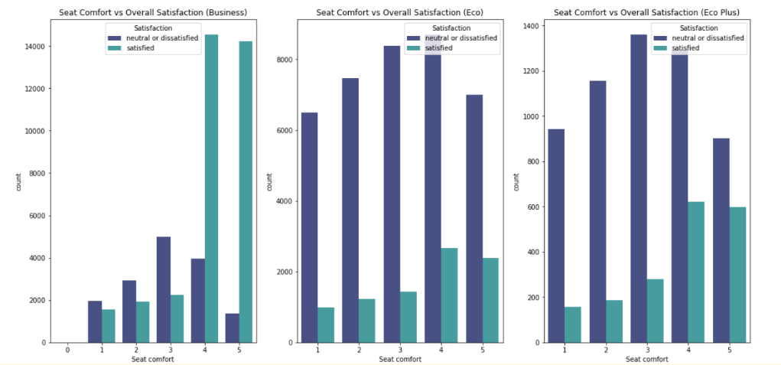
Analysis of satisfaction vs. Seat comfort
How does seat comfort impact the satisfaction levels of passengers?
Analysis:
Within the business class the people who rated seat comfort highly also have displayed higher overall satisfaction. This shows that passengers within this class are very satisfied with the seat comfort and also seat comfort has a positive correlation with overall satisfaction.

Slide 23
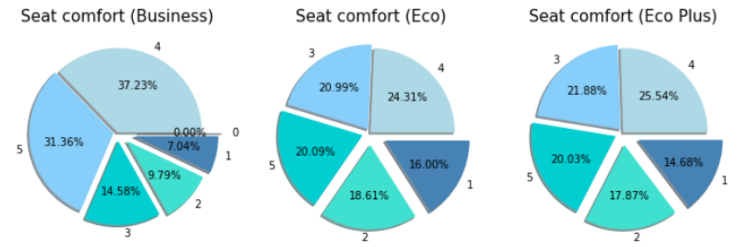
Recommendations:
1. Space is premium for any airline and maximum seats have to be created because all will not be willing to pay extravagant business class fares. The only option is to properly design the seats with optimum ergonomics and pleasant fabrics.
2. Seats can be fitted with elevated headrest to give more comfort as this addition will not reduce number of seats.
3. Seats can have built in massagers to give some comfort to passengers during long flights. This will not impact the number of seats.

Slide 24
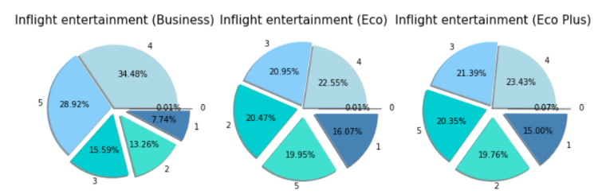
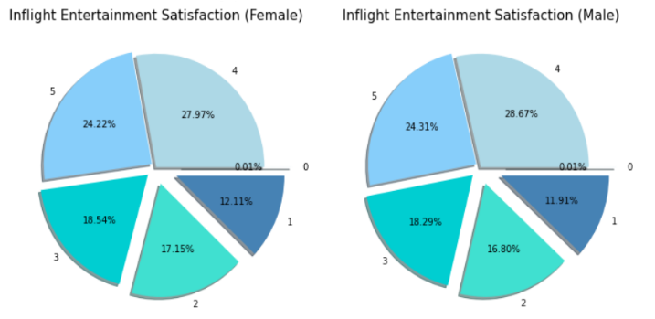
Analysis of satisfaction vs. Inflight entertainment
How does inflight entertainment impact the satisfaction levels of passengers?
Analysis:
Passengers from the Business section have given inflight entertainment the highest rating while the other class passengers are much more dissatisfied with it. This shows that business class passengers have better access to inflight entertainment.
Passengers within eco and eco plus, who were dissatisfied with inflight entertainment also displayed overall dissatisfaction. There is a correlation. Around 30% of the passengers have rated the inflight entertainment as 2 or 1. Gender hasn't affected the satisfaction levels much.

Slide 25
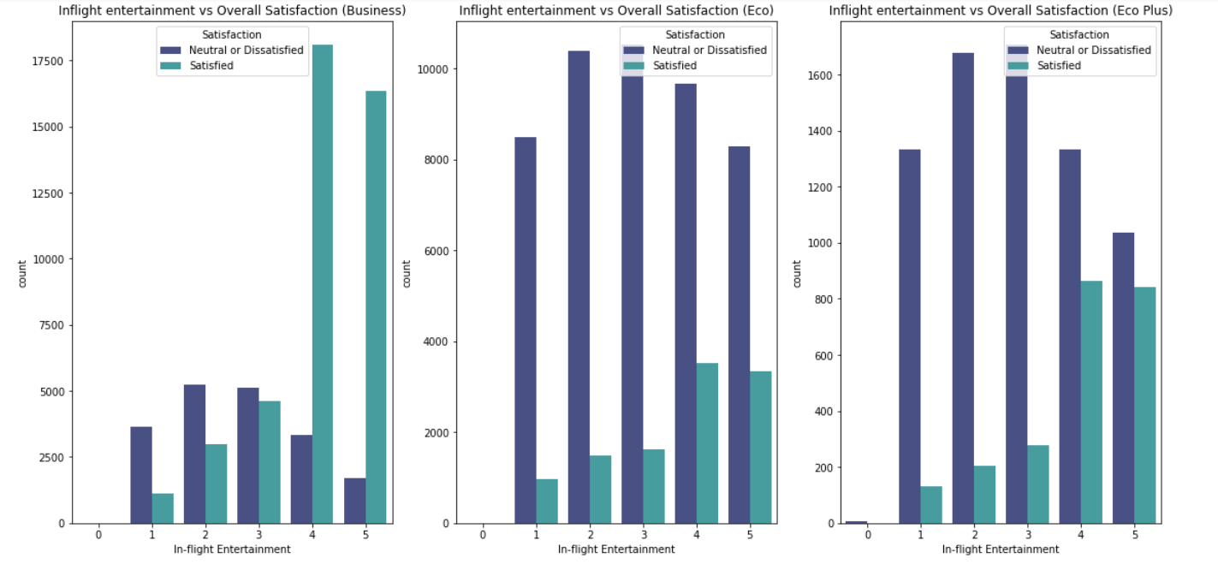
Recommendations:
1. Airlines can keep a few popular magazines and newspapers across aisles. Of course this extra weight should not be high.
2. Multiple inbuilt screen functionalities taking into consideration different languages for international flights; and better headphones.
3. Separating business class and economy class using proper curtains to minimize comparison and perceived discrimination.

Slide 26
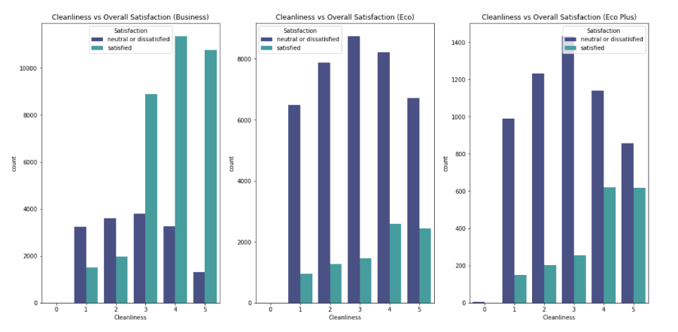
Analysis of satisfaction vs. Cleanliness
How much impact does cleanliness have on overall satisfaction of passengers?
Analysis:
The passengers from Eco and Eco Plus have reported greater inconvenience when it comes to cleanliness and hygiene. Passengers within eco and eco plus, who were dissatisfied with cleanliness also displayed overall dissatisfaction.

Slide 27
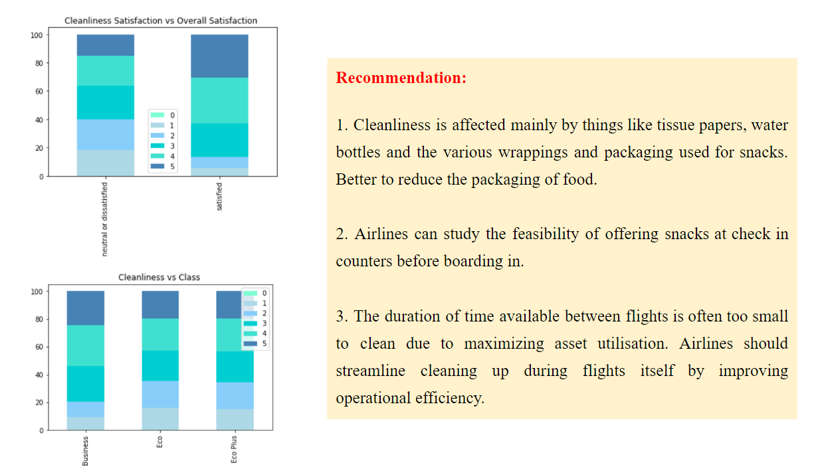

Slide 28
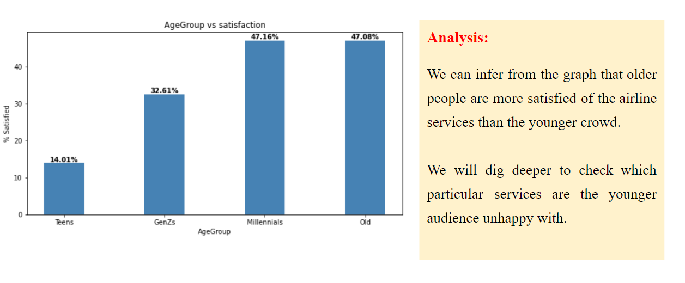
Analysis of satisfaction vs. Age of Customers
How does satisfaction vary across different Age Groups?

Slide 29
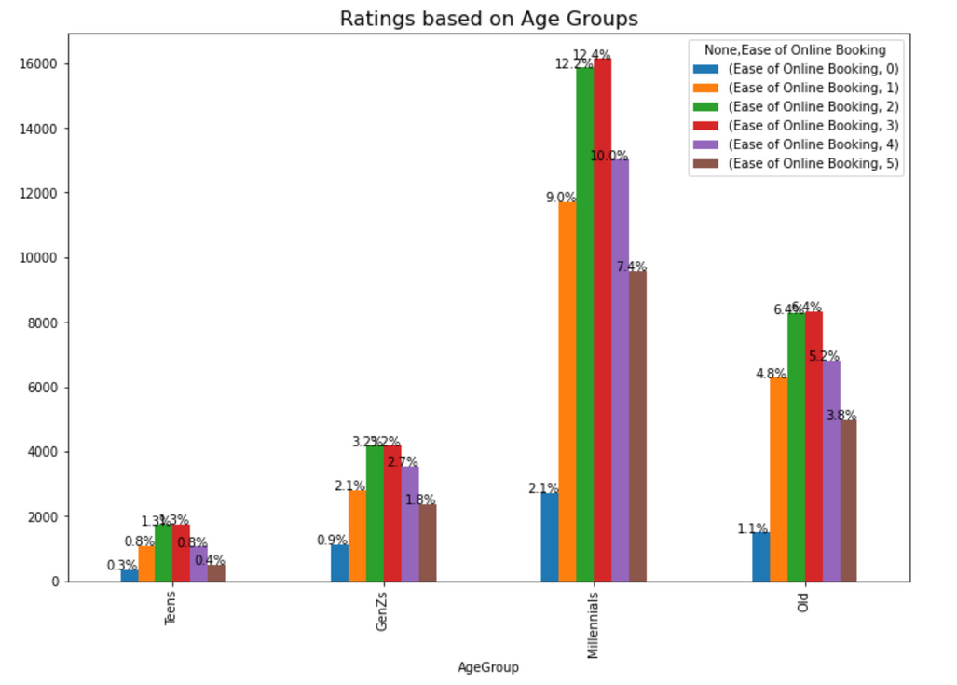
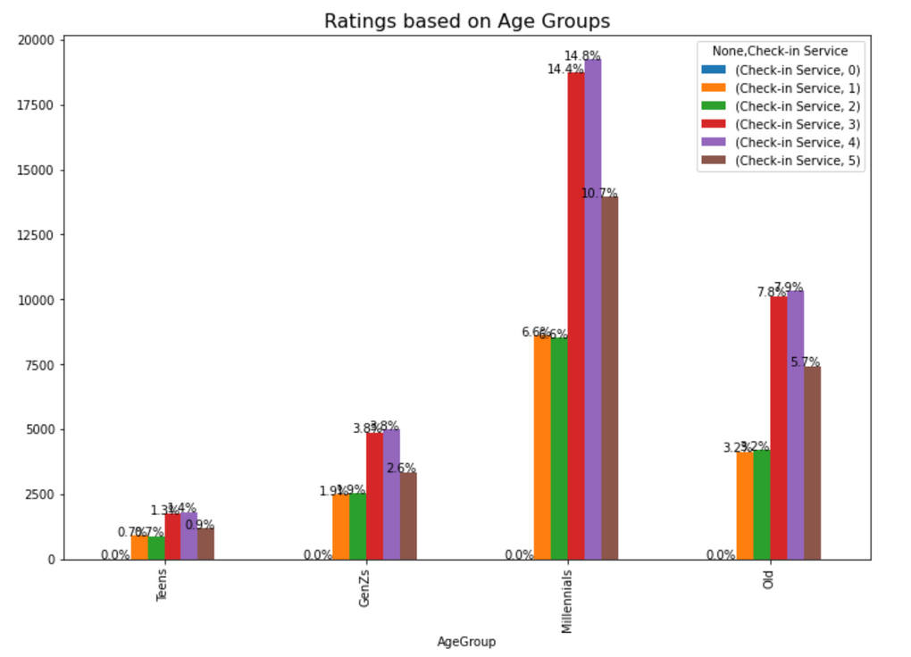
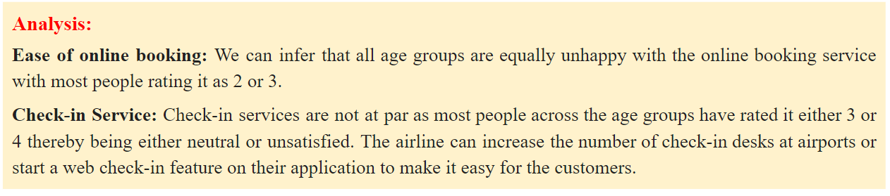

Slide 30
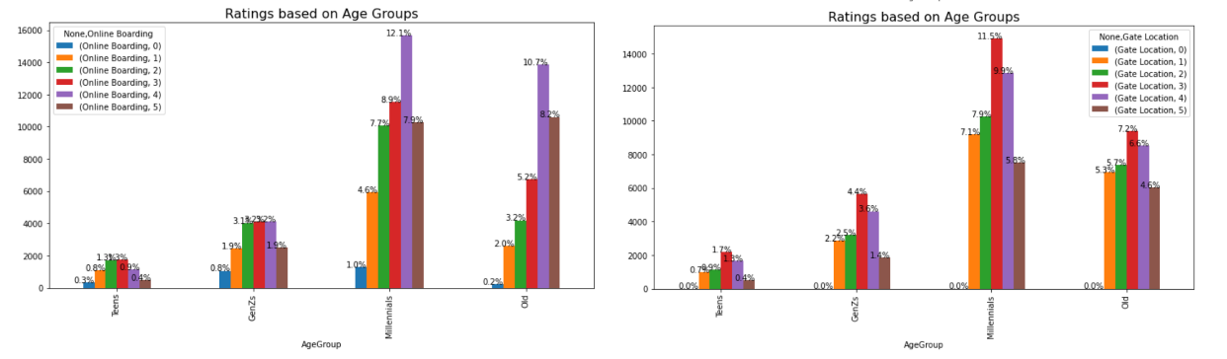
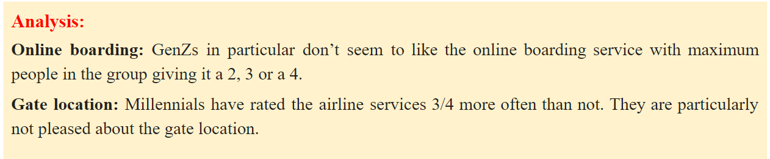

Slide 31
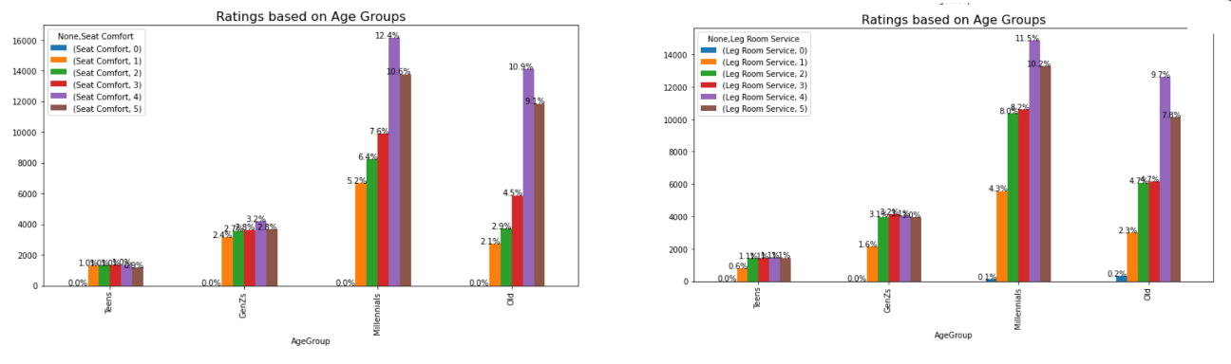
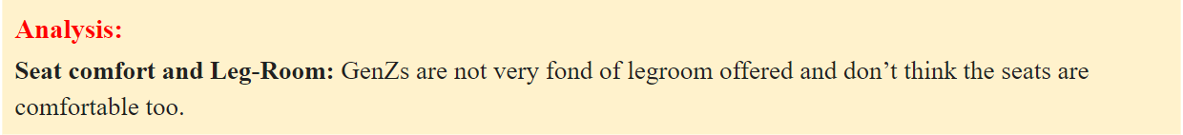

Slide 32
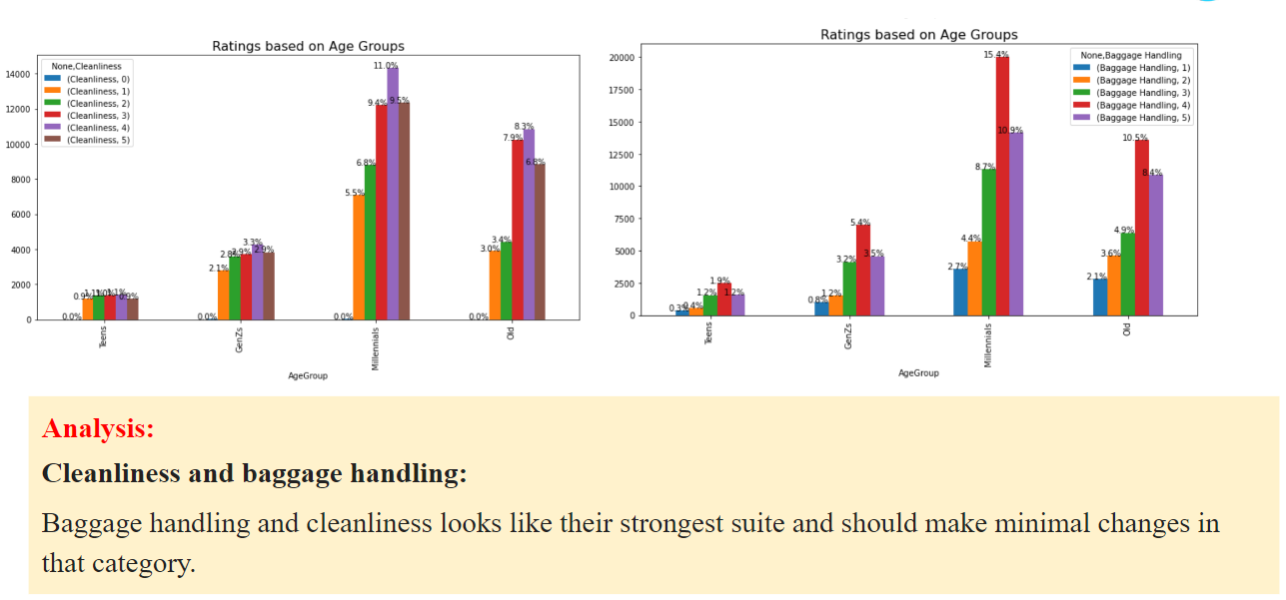

Slide 33
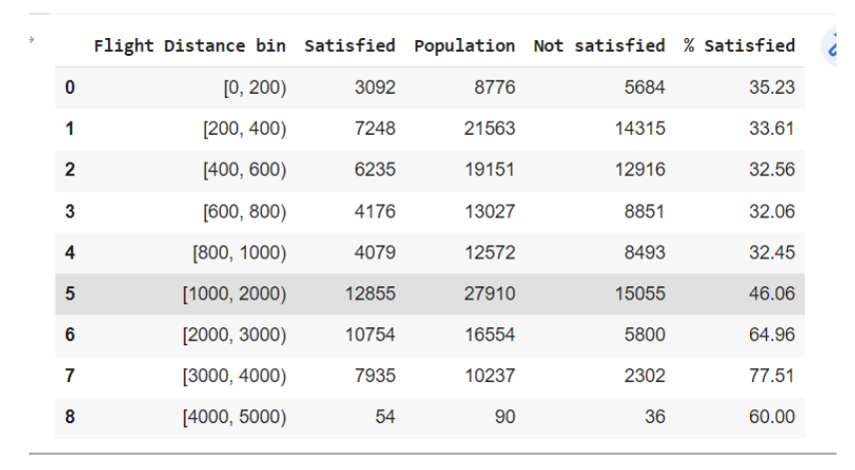
Check of Satisfied percentage vs Flight Distance

Slide 34
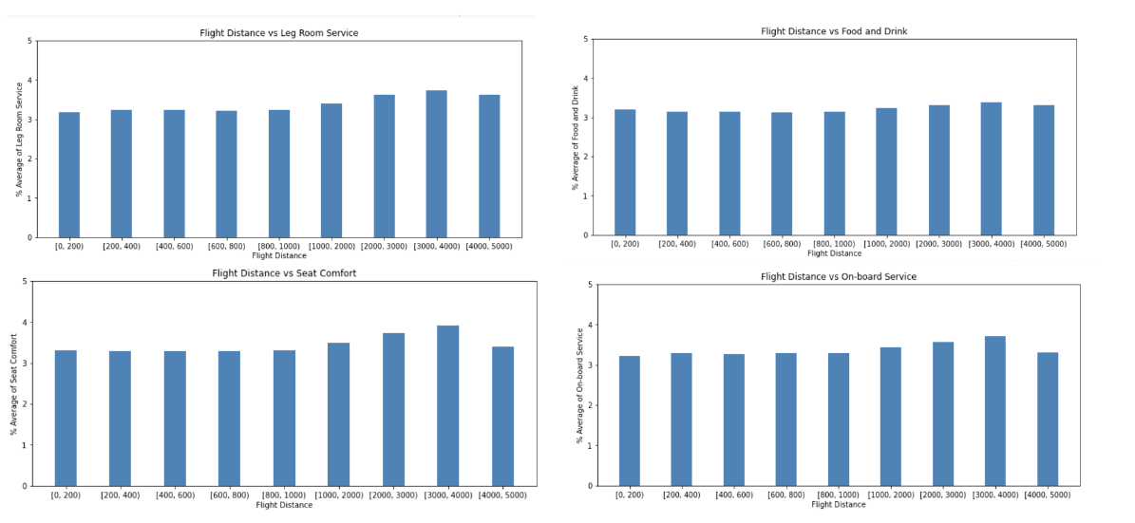
Analysis of satisfaction vs. Flight distance
How does satisfaction vary with flight distance?

Slide 35
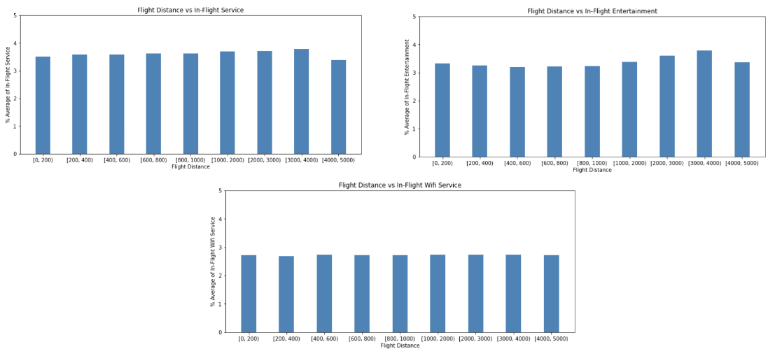
Flight Distance vs other parameters

Slide 36
Analysis
Passengers flying for longer distances are satisfied with the Leg room , Seat comfort, On-Board service and In-flight entertainment.
The point of concern is the rating of the passengers for the In - Flight Wifi service. This rating averages out to 2.75, irrespective of the distance flown.
A suggestion for the airline would be to increase the coverage/speed of the internet connectivity, as a constant rating across distances suggests that the passengers do not run out of internet, but are overall dissatisfied with the speed.
The process of creating a ‘connected airplane’ is changing. Many airlines are continuing to upgrade aircraft fleets for satcom and wifi connectivity, while new-build airliners are increasingly delivered either equipped with IFEC suites, or provisioned ready to accept them with minimal modification.

Slide 37
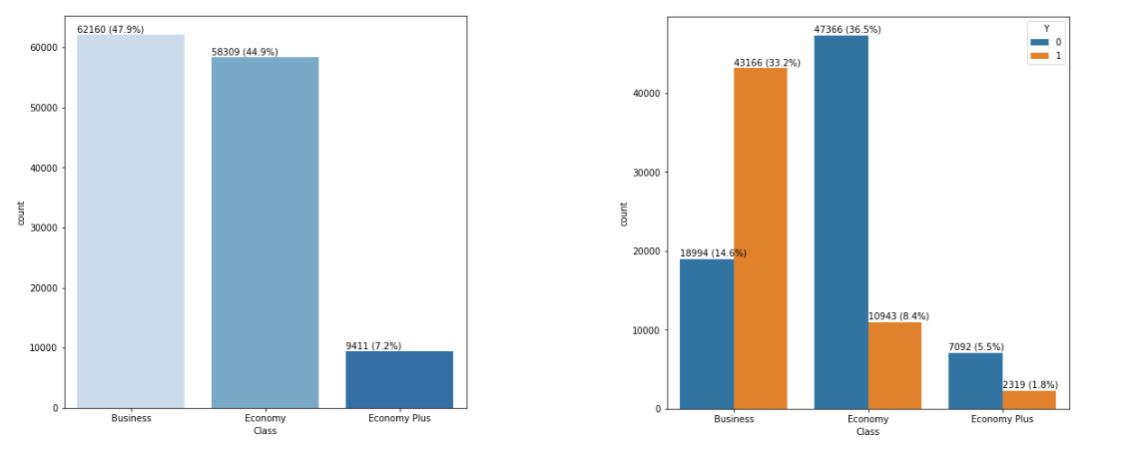
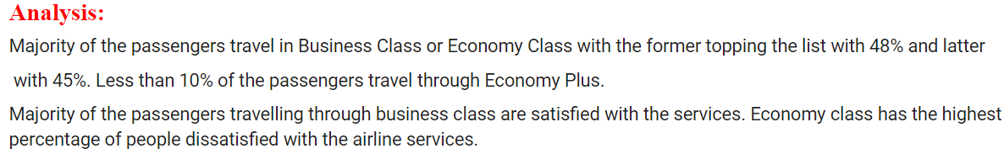
How does Class impact the Satisfaction of the passengers?

Slide 38
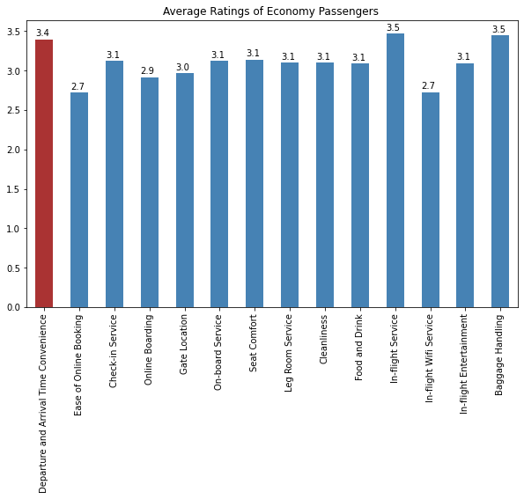
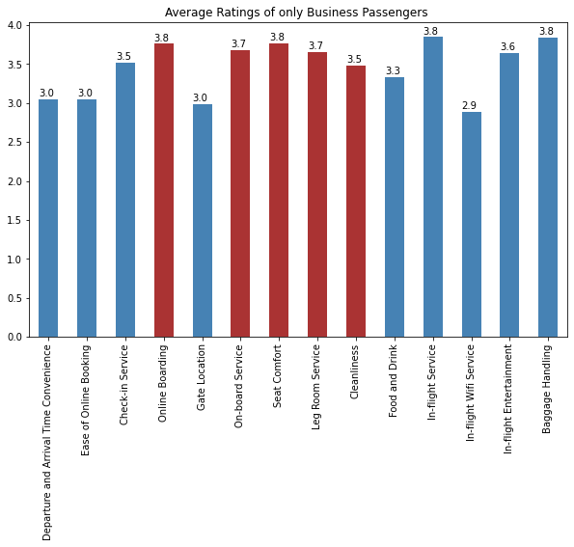
Average User Ratings of passengers in Economy vs Business Class

Slide 39
Analysis
Online Boarding, on board service, Cleanliness, Legroom, Seat Comfort, on-board service has a significantly better for Business Passengers.
Arrival and Departure Time Convenience has a relatively rating in Economy class than Business Class.
Average In-Flight wifi ratings is low in both Economy and Business class.
Ease of Online booking has the lowest average rating in Economy class while it slightly better in Business class.
A suggestion for the airlines could be to improve the online booking interface to make is easy for the passengers to book and improve the overall rating which could lead to a better satisfaction.
Baggage handling and In-flight service has been rated the highest amongst both Business and Economy Classes.

Slide 40
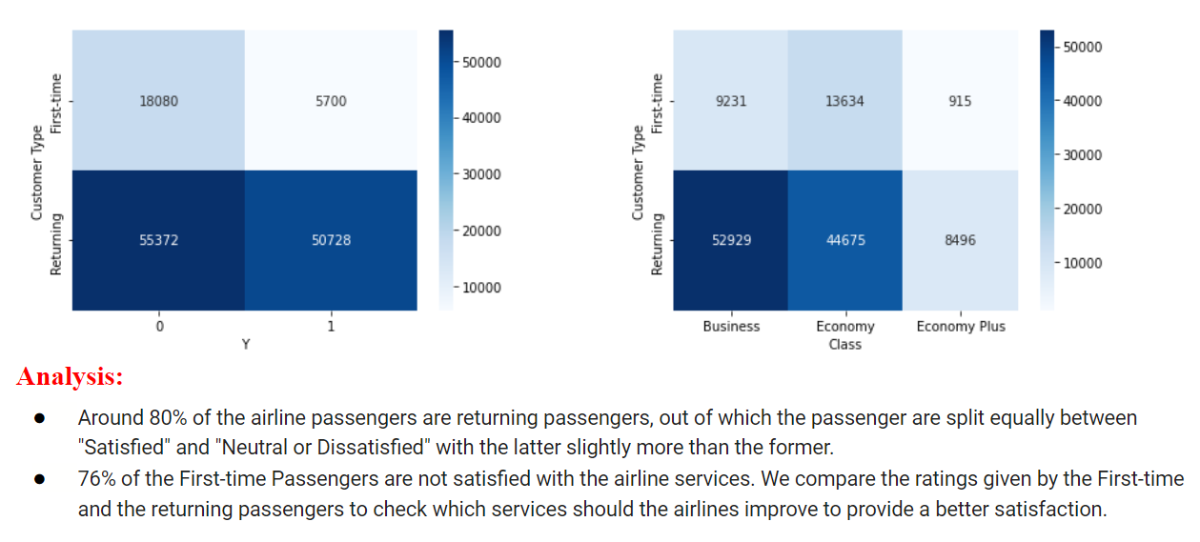
How does the Customer Type impact the satisfaction level.

Slide 41
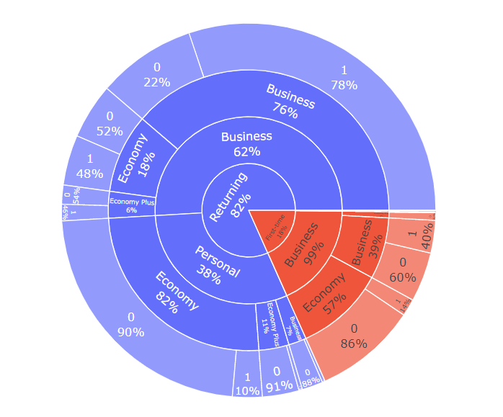
Analysis

Slide 42
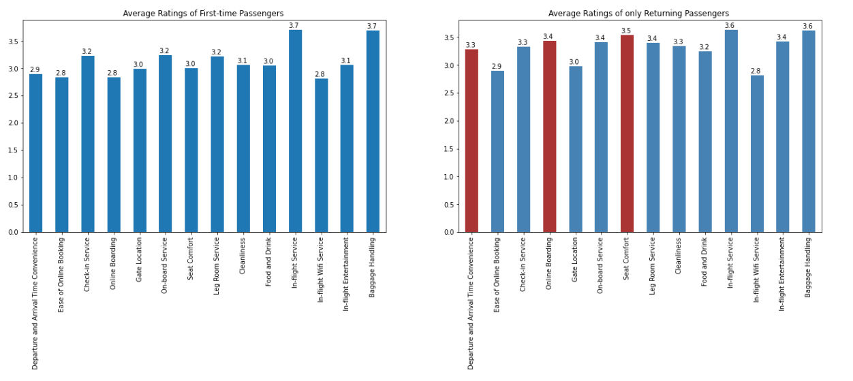
Average User Ratings between First-Timers vs Returning Passengers

Slide 43
Analysis
Returning Passengers rated Departure and arrival time more than the First-timers, and the majority of the passengers are travelling for Business type so it could be possible that the airlines is scheduling flights in accordance to the Business hours.
Also Returning Passengers are more comfortable with the Leg room service and seat comfort compared to the First-timers.
There is a significant difference between the online boarding rating between the first-timers and the returning, since the latter portion of passengers are already aware of the online boarding they are more comfortable.

Slide 44

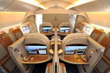


Our final recommendations
Online booking - Modify the app/website. Enable cookies and then for every returning user offer a 1-click ticket purchasing option.
In-flight services - In-flight wifi services has average rating of under 3 consistent with passengers across varying flight distances. Internet connectivity needs to be improved to boost the rating.
Check-in - Simplify the check-in process to reduce queuing and efficiently manage baggage handling
Seat comfort & Leg room - Contrary to the intuition, younger people are not satisfied with these services. To pinpoint to what are the actual issues, airline can conduct a survey/give out a questionnaire to understand their pain points. If not already incorporated, design the eco and eco plus class seats with optimum ergonomics and pleasant fabrics, and proper elevated headrests. Airlines should also see the scope of having innovations like mini built in massagers to help ease fatigue caused by long flight journeys.
Food and Beverages: More than 50% were neutral/dissatisfied due to
Cleanliness: Cut down on the packaging of snacks provided.Airlines can study the feasibility of offering snacks at check in counters before boarding in. The duration of time available between flights is often too small to clean due to focus on maximizing asset utilisation. Airlines should streamline cleaning up during flights itself by improving operational efficiency.
Inflight entertainment: Improve this aspect for eco and eco plus classes. Enhance inbuilt screen functionalities.

Slide 45



Appendix : Code Snippets

Slide 46

Appendix : Code Snippets

Slide 47


Appendix : Code Snippets

Slide 48

Appendix : Code Snippets

Slide 49
THANK YOU

